Slide 1
Business Understanding
Data Preparation
Modelling
Evaluation
Deployment
Data Understanding
The Process
CRISP-DM
Notes:
Cross Industry Standard Process for Data Mining (CRISP-DM)
Breaks everything down into 6 phases
Allows for going bac k a step – more agile approach to understanding
Business Understanding
An initial opportunity assessment
Identification of the business questions that are candidates for the solutions
Problem formulation
Cost-benefit analysis
Understanding Data
Identifying data types (string, integer, dates, boolean)
Determining the distribution (Discrete/Categorical or Continuous)
Population of values or identification missing values (dense or sparse)
Generating a statistical profile of the data (Min, Max, Mean, Counts, Distinct Count, etc)
Identifying correlation within the data set
Data science involves:
Finding data
Acquiring data
Cleaning and transforming data
Understanding relationships in data
Delivering value from data

Slide 2
Visualization & Exploration
Fundamentals of Statistics

Slide 3
Considering
Categorical Data

Slide 4
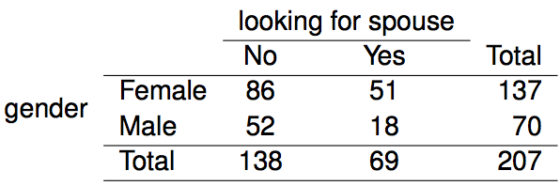
Contingency Tables
A table that summarizes data for two categorical variables is called a contingency table.
The contingency table below shows the distribution of students' genders and whether or not they are looking for a spouse while in college.

Slide 5
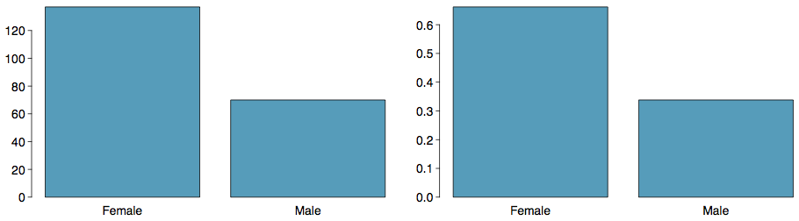
Bar Plots
A bar plot is a common way to display a single categorical variable. A bar plot where proportions instead of frequencies are shown is called a relative frequency bar plot.
How are bar plots different than histograms?
Bar plots are used for displaying distributions of categorical variables, while histograms are used for numerical variables. The x-axis in a histogram is a number line, hence the order of the bars cannot be changed, while in a bar plot the categories can be listed in any order (though some orderings make more sense than others, especially for ordinal variables.)

Slide 6
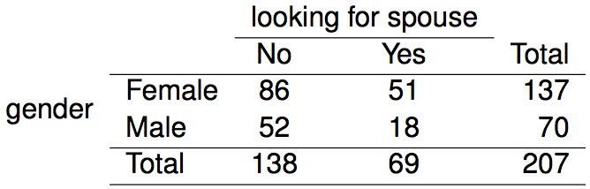
Choosing the
Appropriate Proportion
Does there appear to be a relationship between gender and whether the student is looking for a spouse in college?
To answer this question we examine the row proportions:
% Females looking for a spouse: 51 / 137 ~ 0.37
% Males looking for a spouse: 18 / 70 ~ 0.26

Slide 7
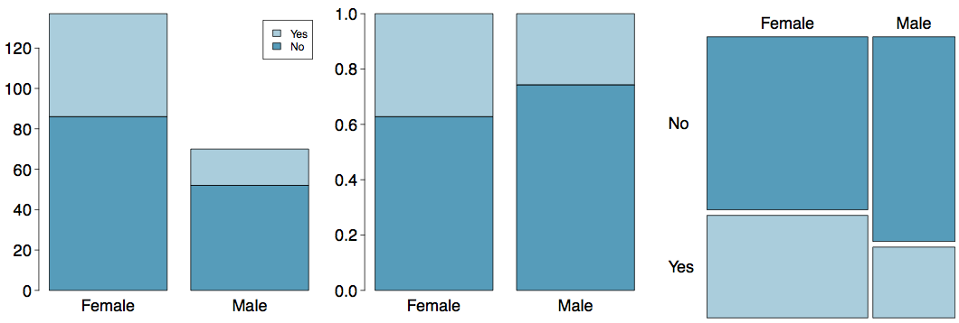
Segmented Bar and Mosaic Plots
What are the differences between the three visualizations shown below?

Slide 8
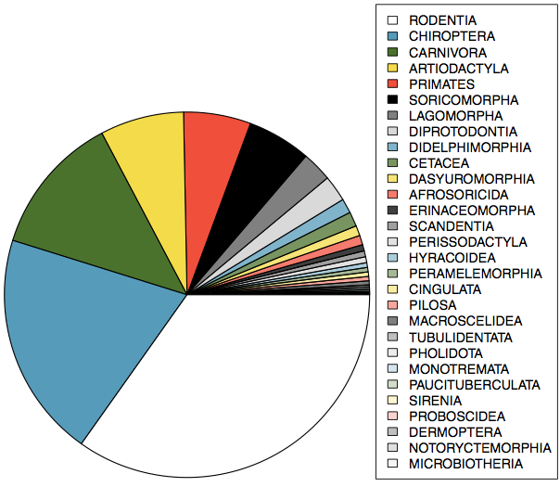
Pie Charts
Can you tell which order encompasses the lowest percentage of mammal species?
http://www.bucknell.edu/msw3

Slide 9
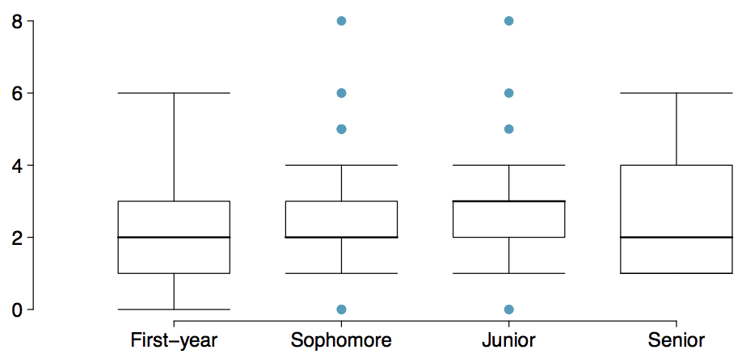
Comparing Numerical Data
Across Groups
Does there appear to be a relationship between class year and number of clubs students are in?

Slide 11
Examining
Numerical Data

Slide 12
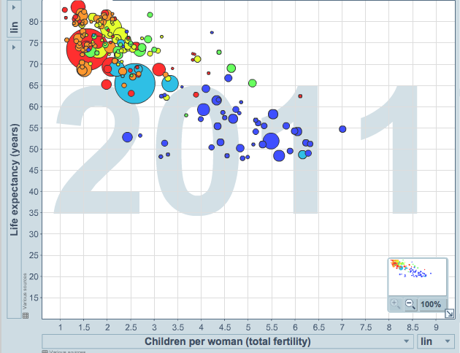
Scatterplot
Scatterplots are useful for visualizing the relationship between two numerical variables.
Do life expectancy and total fertility appear to be associated or independent?
Was the relationship the same throughout the years, or did it change?
They appear to be linearly and negatively associated: as fertility increases, life expectancy decreases.
The relationship changed over the years.
http://www.gapminder.org/world

Slide 13
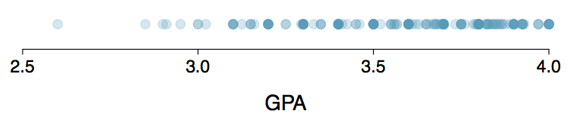
Dot Plots
Useful for visualizing one numerical variable. Darker colors represent areas where there are more observations.
How would you describe the distribution of GPAs in this data set? Make sure to say something about the center, shape, and spread of the distribution.

Slide 14
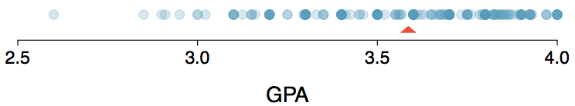
Dot Plots & Mean
The mean, also called the average (marked with a triangle in the above plot), is one way to measure the center of a distribution of data.
The mean GPA is 3.59.

Slide 15

Mean
The sample mean, denoted as x̄, can be calculated as
where x₁, x₂, ..., x_{n} represent the n observed values.
The population mean is also computed the same way but is denoted as µ. It is often not possible to calculate µ since population data are rarely available.
The sample mean is a sample statistic, and serves as a point estimate of the population mean. This estimate may not be perfect, but if the sample is good (representative of the population), it is usually a pretty good estimate.

Slide 16
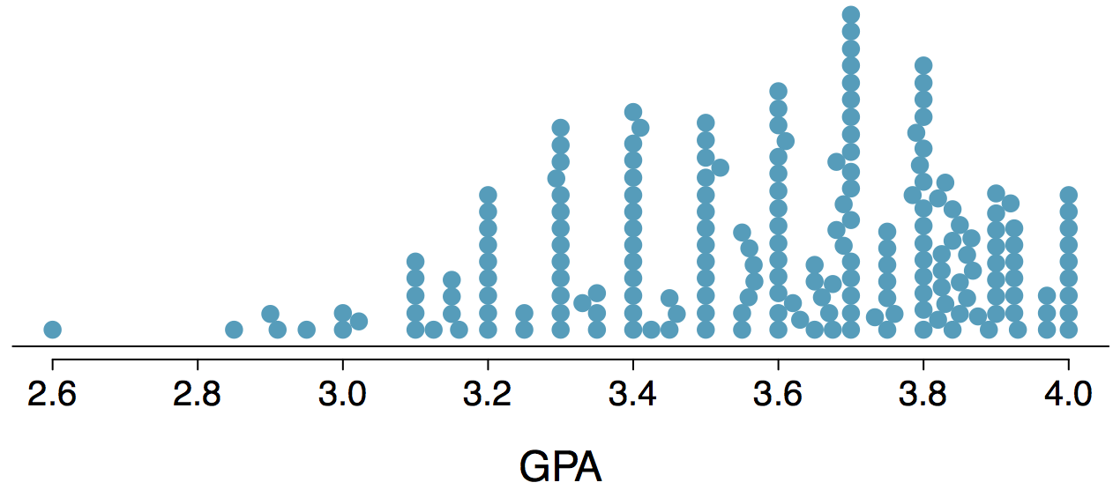
Stacked Dot Plot
Higher bars represent areas where there are more observations, makes it a little easier to judge the center and the shape of the distribution.

Slide 17
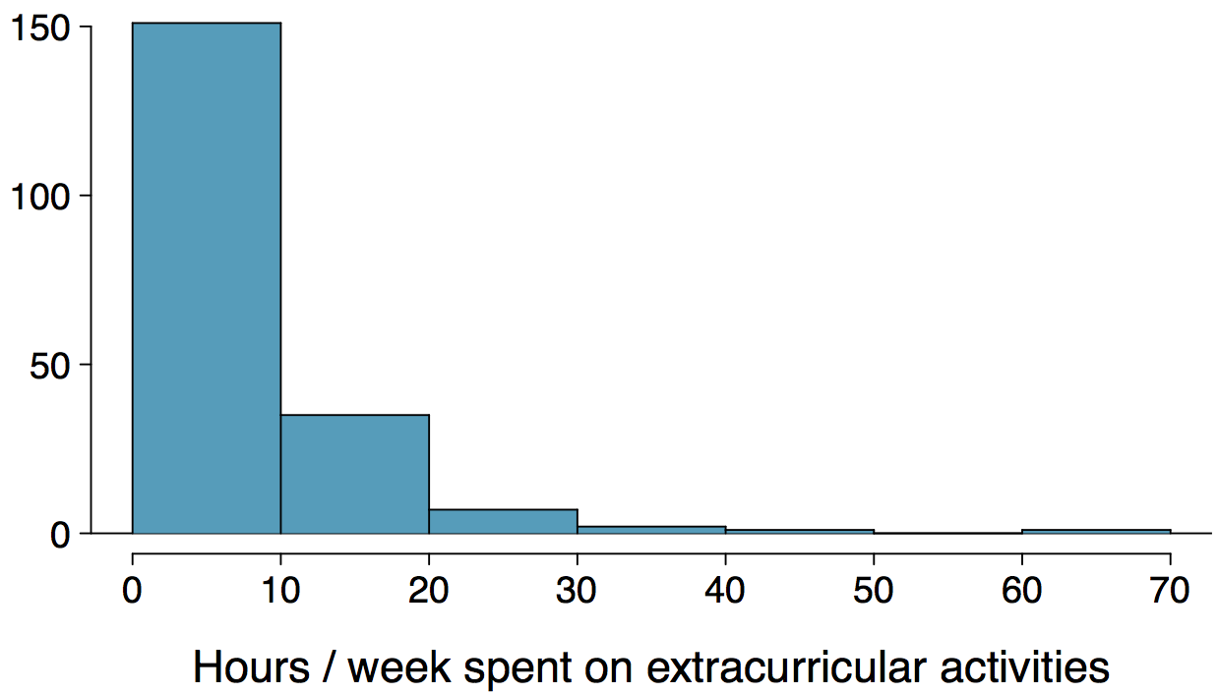
Histograms - Extracurricular Hours
Histograms provide a view of the data density. Higher bars represent where the data are relatively more common.
Histograms are especially convenient for describing the shape of the data distribution.
The chosen bin width can alter the story the histogram is telling.

Slide 18
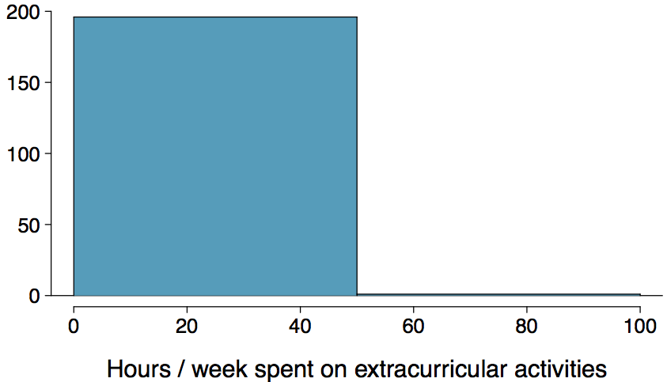
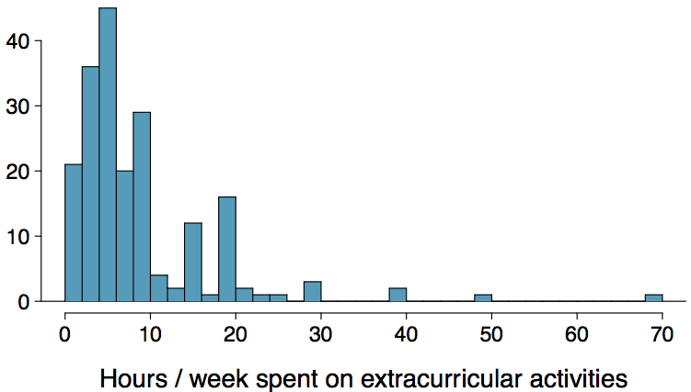
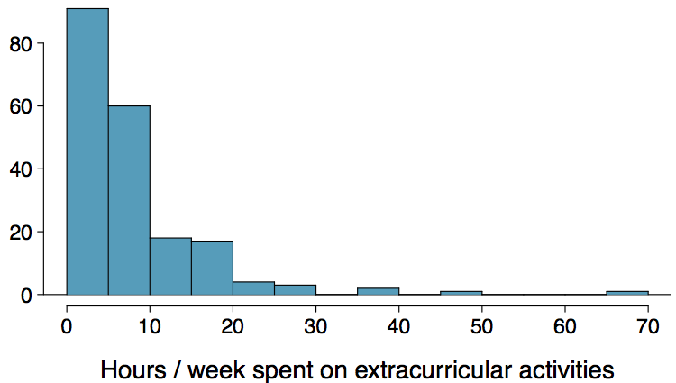
Bin Width
Which one(s) of these histograms are useful? Which reveal too much about the data? Which hide too much?

Slide 19
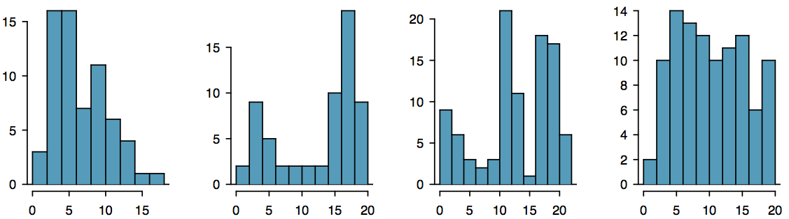
Shape of a Distribution: Modality
Does the histogram have a single prominent peak (unimodal), several prominent peaks (bimodal/multimodal), or no apparent peaks (uniform)?
Note: In order to determine modality, step back and imagine a smooth curve over the histogram -- imagine that the bars are wooden blocks and you drop a limp spaghetti over them, the shape the spaghetti would take could be viewed as a smooth curve.

Slide 20
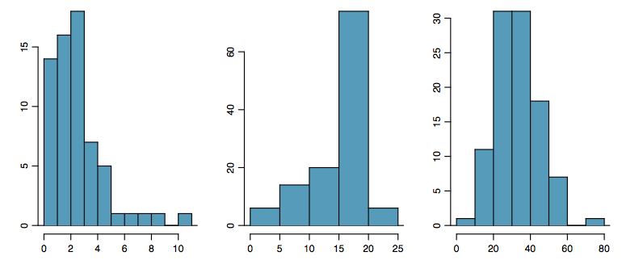
Shape of a Distribution: Skewness
Is the histogram right skewed, left skewed, or symmetric?
Histograms are said to be skewed to the side of the long tail.

Slide 21
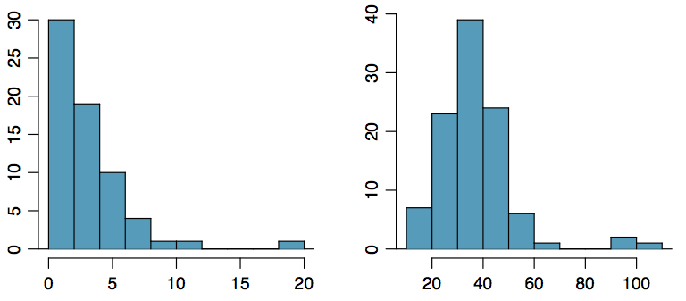
Shape of a Distribution:
Unusual Observations
Are there any unusual observations or potential outliers?

Slide 22
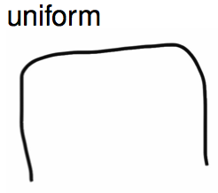
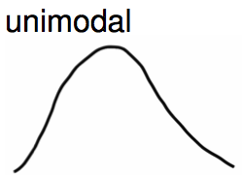
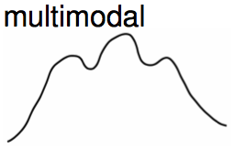
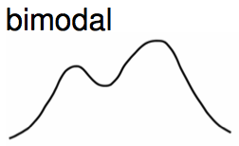
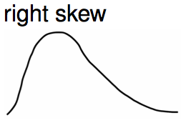
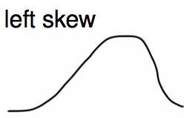
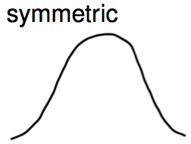
Commonly observed shapes of distributions
Modality
Skewness

Slide 23
Practice
Which of these variables do you expect to be uniformly distributed?
(a) weights of adult females
(b) salaries of a random sample of people from North Carolina
(c) house prices
(d) birthdays of classmates (day of the month)

Slide 24
Practice
Which of these variables do you expect to be uniformly distributed?
(a) weights of adult females
(b) salaries of a random sample of people from North Carolina
(c) house prices
(d) birthdays of classmates (day of the month)

Slide 25
Application Activity:
Shapes of Distributions
Sketch the expected distributions of the following variables:
number of piercings
scores on an exam
IQ scores
Come up with a concise way (1-2 sentences) to teach someone how to determine the expected distribution of any variable.

Slide 26

Are you typical?
http://www.youtube.com/watch?v=4B2xOvKFFz4
How useful are centers alone for conveying the true characteristics of a distribution?

Slide 27


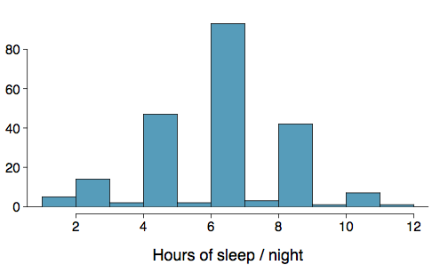
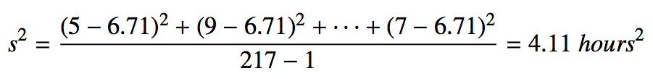
Variance
Variance is roughly the average squared deviation from the mean.
The sample mean is and the sample size is n = 217.
The variance of amount of sleep students get per night can be calculated as:

Slide 28
Variance (cont.)
Why do we use the squared deviation in the calculation of variance?
To get rid of negatives so that observations equally distant from the mean are weighed equally.
To weigh larger deviations more heavily.

Slide 29

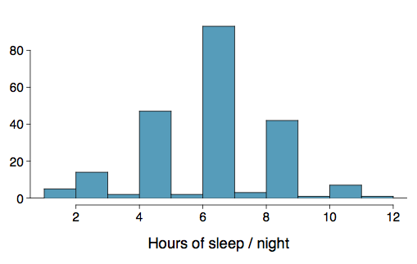

Standard Deviation
The standard deviation is the square root of the variance, and has the same units as the data.
The standard deviation of amount of sleep students get per night can be calculated as:
We can see that all of the data are within 3 standard deviations of the mean.

Slide 30

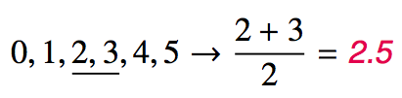
Median
The median is the value that splits the data in half when ordered in ascending order.
If there are an even number of observations, then the median is the average of the two values in the middle.
Since the median is the midpoint of the data, 50% of the values are below it. Hence, it is also the 50th percentile.

Slide 31
Q1, Q3, and IQR
The 25th percentile is also called the first quartile, Q1.
The 50th percentile is also called the median.
The 75th percentile is also called the third quartile, Q3.
Between Q1 and Q3 is the middle 50% of the data. The range these data span is called the interquartile range, or the IQR.
IQR = Q3 - Q1

Slide 32
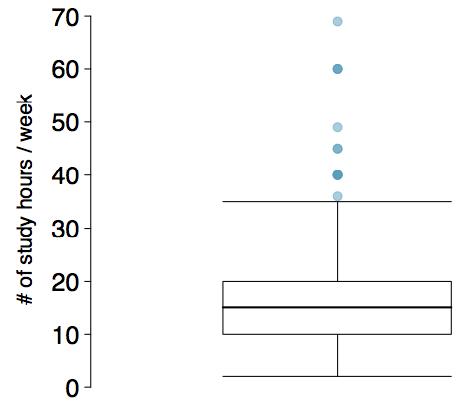
Box Plot
The box in a box plot represents the middle 50% of the data, and the thick line in the box is the median.

Slide 33
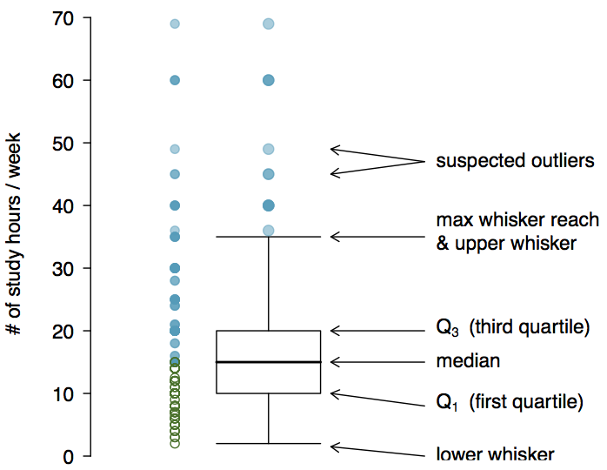
Anatomy of a Box Plot

Slide 34
Whiskers and Outliers
Whiskers of a box plot can extend up to 1.5 x IQR away from the quartiles.
max upper whisker reach = Q3 + 1.5 x IQR
max lower whisker reach = Q1 - 1.5 x IQR
IQR: 20 - 10 = 10
max upper whisker reach = 20 + 1.5 x 10 = 35
max lower whisker reach = 10 - 1.5 x 10 = -5
A potential outlier is defined as an observation beyond the maximum reach of the whiskers. It is an observation that appears extreme relative to the rest of the data.

Slide 35
Outliers (cont.)
Why is it important to look for outliers?
Identify extreme skew in the distribution.
Identify data collection and entry errors.
Provide insight into interesting features of the data.

Slide 36
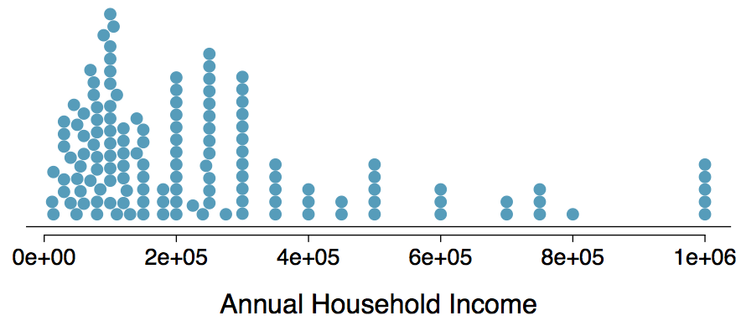
Extreme Observations
How would sample statistics such as mean, median, SD, and IQR of household income be affected if the largest value was replaced with $10 million? What if the smallest value was replaced with $10 million?

Slide 37
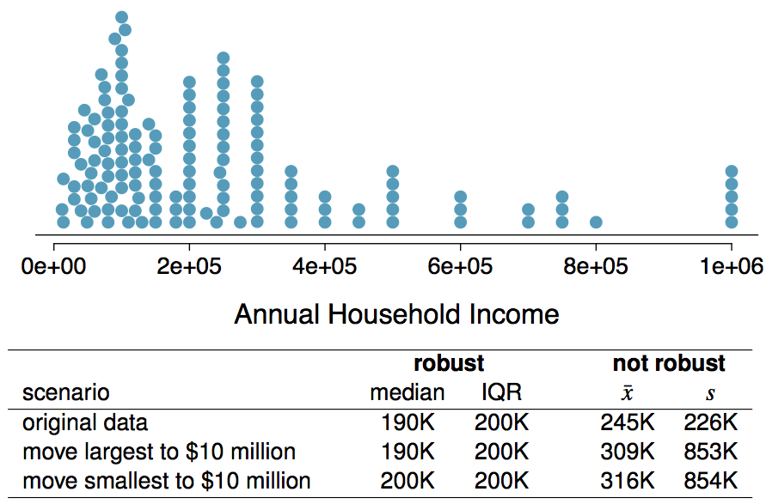
Robust Statistics

Slide 38
Robust Statistics
Median and IQR are more robust to skewness and outliers than mean and SD. Therefore,
for skewed distributions it is often more helpful to use median and IQR to describe the center and spread
for symmetric distributions it is often more helpful to use the mean and SD to describe the center and spread
If you would like to estimate the typical household income for a student, would you be more interested in the mean or median income?
Median

Slide 39
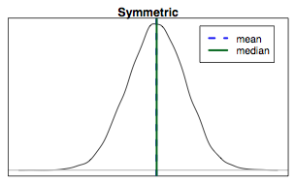
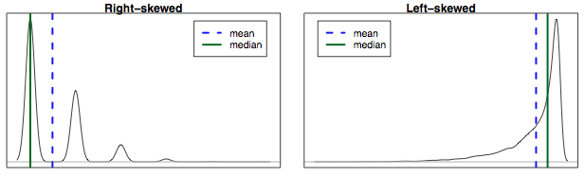
Mean vs. Median
If the distribution is symmetric, center is often defined as the mean: mean ~ median
If the distribution is skewed or has extreme outliers, center is often defined as the median
Right-skewed: mean > median
Left-skewed: mean < median

Slide 40
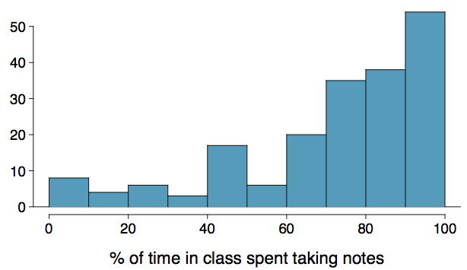
Practice
Which is most likely true for the distribution of percentage of time actually spent taking notes in class versus on Facebook, Twitter, etc.?
(a) mean > median (b) mean ~ median
(c) mean < median (d) impossible to tell

Slide 41
Practice
Which is most likely true for the distribution of percentage of time actually spent taking notes in class versus on Facebook, Twitter, etc.?
median: 80%
mean: 76%
(a) mean > median (b) mean ~ median
(c) mean < median (d) impossible to tell

Slide 42
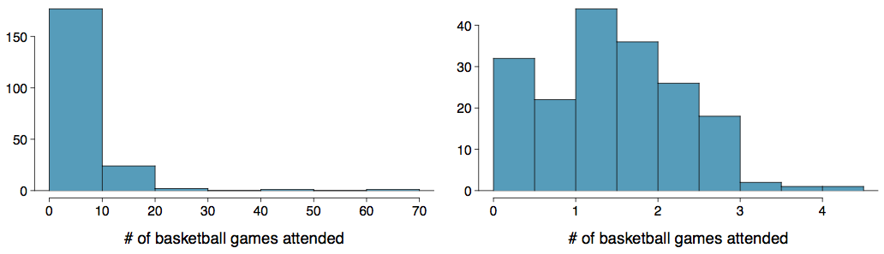
Extremely Skewed Data
When data are extremely skewed, transforming them might make modeling easier. A common transformation is the log transformation.
The histograms on the left shows the distribution of number of basketball games attended by students. The histogram on the right shows the distribution of log of number of games attended.

Slide 43
Pros and Cons of Transformations
Skewed data are easier to model with when they are transformed because outliers tend to become far less prominent after an appropriate transformation.
# of games 70 50 25 …
# of games 4.25 3.91 3.22 ...
However, results of an analysis might be difficult to interpret because the log of a measured variable is usually meaningless.
What other variables would you expect to be extremely skewed?
Salary, housing prices, etc.

